Slide 1

BenAIgn:
Addressing the AI Safety Gap

Slide 2
Table of Contents
01
Introduction
02
Understanding the AI Safety Gap
03
The Current State of AI Safety Research
04
Data and Evidence of the AI Safety Gap
05
Solutions and Mitigation Strategies
06
The Path Forward

Slide 3
Introduction

Slide 4
Defining AI Safety
What is AI Safety?
Scope of AI Safety Concerns
AI safety refers to the field dedicated to preventing unintended consequences from increasingly advanced AI systems; ensuring AI aligns with human values and goals is paramount.
AI safety addresses a wide range of concerns, from bias in algorithms to existential risks posed by superintelligent AI. Addressing these concerns comprehensively is crucial
Why AI Safety Matters
The potential impact of AI on society is vast; therefore proactive safety measures are essential to mitigate risks associated with autonomous systems and advanced machine learning.

Slide 5
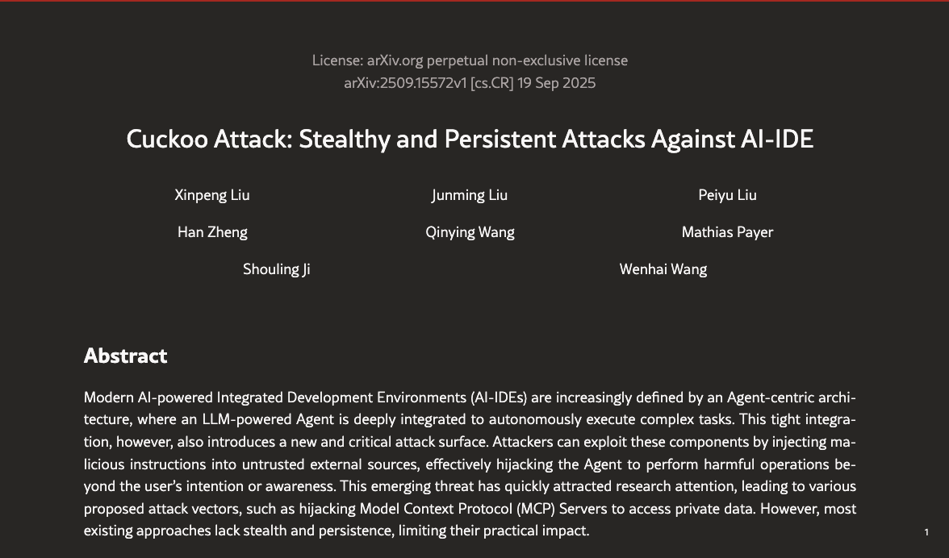
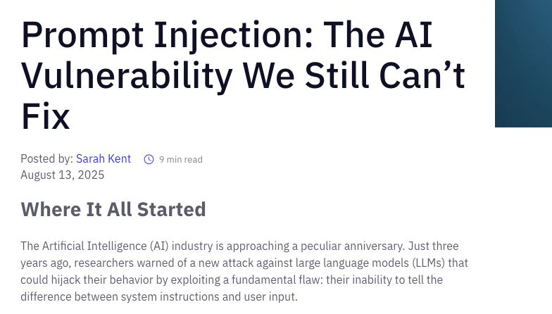
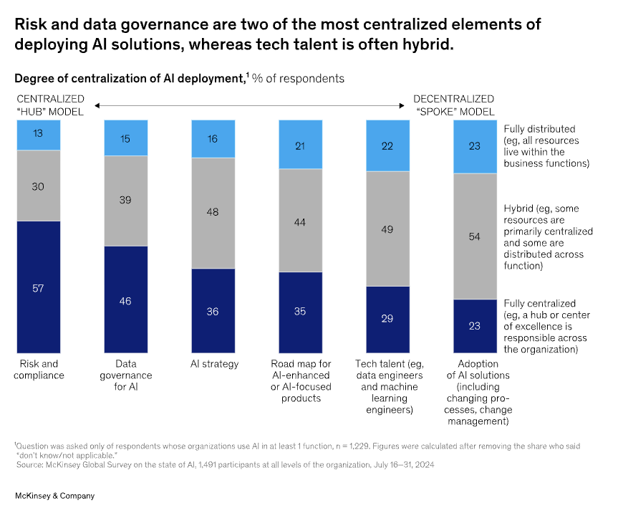
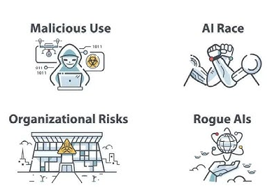


Slide 6
The Emerging AI Landscape
Exponential Growth of AI Capabilities
AI Adoption Across Industries
Societal Impact and Ethical Considerations
AI technologies are advancing at an unprecedented rate, leading to increasingly complex and potentially unpredictable systems; this rapid development necessitates heightened vigilance.
AI is transforming industries from healthcare to finance, and the widespread integration of AI highlights the need for robust safety protocols and guidelines; adaptation is key.
AI's influence extends beyond technological advancements, and ethical considerations are critical to navigate societal impacts such as job displacement and algorithmic bias.

Slide 7
Purpose of the Presentation
Addressing the AI Safety Gap
Increased capabilities without safeguards can be detrimental.
Overview of Current Challenges
Technical hurdles to policy and governance issues; a holistic view is required.
Encouraging Dialogue and Collaboration
By raising awareness and fostering conversations,

Slide 8
Understanding the AI Safety Gap
02

Slide 9
Technical Challenges
Robustness and Reliability
AI systems must be robust against adversarial attacks and reliable in unpredictable environments; system failures can lead to real-world harm.
Alignment with Human Values
Ensuring that AI systems align with human values and goals is a major challenge, because misalignment can lead to unintended and harmful consequences.
Explainability and Interpretability
The "black box" nature of complex AI models makes it difficult to understand their decisions, so transparency is essential for accountability and building trust.

Slide 10
Governance and Policy Gaps
Lack of Comprehensive Regulations
Ethical Frameworks and Guidelines
International Cooperation
The absence of comprehensive regulations and standards for AI development and deployment poses significant risks, so clear guidelines are needed.
Ethical frameworks are essential to guide AI development, but they must be adaptable and enforceable to address emerging ethical dilemmas.
AI safety requires international cooperation to address cross-border issues and ensure a unified approach to AI governance; silos must be broken down.

Slide 11
Resource Allocation and Investment
Underfunding of AI Safety Research
Talent Shortage in AI Safety
Prioritization of Short-Term Gains
AI safety research is often underfunded compared to AI development, and this disparity hinders progress in addressing safety concerns.
There is a growing demand for AI safety experts, but talent shortages limit the capacity to address complex safety challenges effectively.
The prioritization of short-term gains over long-term safety considerations in AI development poses risks because sacrificing safety can lead to future crises

Slide 12
The Current State of AI Safety Research
03

Slide 13
Overview of Key Research Areas
Formal Verification and Testing
Adversarial Robustness Techniques
Value Alignment Methods
Formal verification and rigorous testing methods are used to ensure AI systems meet safety specifications; these measures are crucial for reliability.
Researchers are developing techniques to enhance the robustness of AI systems against adversarial attacks, because system vulnerabilities can be exploited.
Value alignment methods aim to align AI goals with human values, and this field is crucial for ensuring AI acts in accordance with human intentions.

Slide 14
Progress and Limitations
O1
O2
O3
Advances in Specific Domains
Scalability Issues
Limited Real-World Deployment
There have been advances in AI safety within specific domains, but generalizing these findings to broader AI systems remains challenging; context matters.
Many AI safety solutions face scalability issues when applied to large-scale AI models, and therefore scalable solutions are needed for real-world deployment.
Despite research progress, the real-world deployment of AI safety techniques is limited, so practical implementation is essential.

Slide 15
Case Studies and Examples
Autonomous Vehicles
The safety of autonomous vehicles is a critical concern due to the potential for accidents and fatalities; rigorous testing and regulations are essential.
Healthcare AI
AI in healthcare must ensure patient safety and privacy, so ethical guidelines and data protection measures are paramount.
Financial Risk Management
AI-driven financial risk management systems must be robust and transparent to prevent financial crises, and accountability is crucial.

Slide 16
Data and Evidence of the AI Safety Gap
04

Slide 17
Quantifiable Metrics
01
02
03
Frequency of AI-Related Incidents
Economic Losses Due to AI Failures
Social Impact Metrics
Data on the frequency of AI-related incidents, such as accidents involving autonomous systems, highlights the need for improved safety measures; incident tracking is key.
Quantifying economic losses resulting from AI failures demonstrates the financial impact of safety gaps, and this data can drive investment in safety measures.
Social impact metrics assess the effects of AI on employment, fairness, and societal well-being; understanding these impacts is crucial for policy-making.

Slide 18
Expert Opinions and Surveys
Surveys of AI Researchers
Industry Leader Perspectives
Ethical Advisory Boards
Surveys of AI researchers provide insights into their perceptions of AI safety risks and priorities; expert opinions guide research and policy.
Industry leaders perspectives on AI safety shape investment decisions and corporate responsibility initiatives; their commitment is essential.
Ethical advisory boards provide guidance on ethical AI development and deployment; their recommendations ensure ethical considerations are integrated into practice.

Slide 19
Real-World Examples
Misinformation and Disinformation Campaigns
Algorithmic Bias in Criminal Justice
Autonomous Weapons Systems
AI-driven misinformation and disinformation campaigns pose threats to democracy and social stability, and addressing these threats is critical.
Examples of algorithmic bias in criminal justice systems demonstrate the potential for AI to perpetuate discrimination, because fairness is paramount.
The development of autonomous weapons systems raises significant ethical and safety concerns; international regulations are urgently needed.
01
02
03

Slide 20
Solutions and Mitigation Strategies
05

Slide 21
Improving Technical Safety
Developing More Robust AI Models
Enhancing Explainability Techniques
Incorporating Safety Mechanisms
Developing more robust AI models that are resistant to adversarial attacks and capable of handling uncertainty is essential; resilience matters.
Enhancing explainability techniques allows for better understanding and oversight of AI decision-making and therefore transparency is key.
Incorporating safety mechanisms such as kill switches and human-in-the-loop systems can mitigate risks in critical applications; safety nets are crucial.

Slide 22
Policy and Governance Frameworks
Establishing Clear Regulatory Standards
Establishing clear regulatory standards for AI development and deployment ensures accountability and safety; standards provide a framework.
Fostering International Collaboration
Fostering international collaboration on AI safety ensures a unified approach to addressing global challenges and risks; acting together is vital.
Promoting Ethical Guidelines
Promoting ethical guidelines and best practices guides AI developers and ensures ethical considerations are integrated into AI systems.

Slide 23
Resource and Investment Strategies
Increasing Funding for AI Safety Research
Attracting and Training AI Safety Experts
Incentivizing Responsible AI Development
Increasing funding for AI safety research accelerates progress in addressing critical safety challenges because investment drives innovation.
Attracting and training AI safety experts addresses talent shortages and strengthens the AI safety workforce; education is key.
Incentivizing responsible AI development encourages the creation of safe and ethical AI systems; incentives promote responsibility.

Slide 24


How it works?
PROMPT INJECTION DETECTOR
User Input Sent
CyberHawk Intercepts
Threat Detection System Analyses
Decision Engine Approves/Blocks
Only Safe Input Goes to LLM
Response Sent Back Safely
BenAIgn
Forbidden
Yes
Flagged?
No
LLM chatbot

Slide 25
How it works?
BenAIgn
BenAIgn Inteface
(integrated with Client Interface)
Threat Detector
Prompt Injection
Malicious commands
Sandbox Bypass
Inference Attack
Obfuscated Inputs
input text
input file
LLM chatbot
input image
No
Flagged
Yes
Forbidden/Bad input
Forbidden
Valid Response

Slide 26
The Path Forward
06

Slide 27
Call to Action
Encouraging Multidisciplinary Collaboration
Encouraging multidisciplinary collaboration among AI researchers, policymakers, ethicists, and the public ensures a holistic approach to AI safety.
Advocating for Proactive Measures
Advocating for proactive safety measures and policies prevents potential harm and builds a foundation for responsible AI development.
Raising Public Awareness
Raising public awareness about AI safety issues helps foster informed discussions and support for safety initiatives because awareness drives change.

Slide 28
Future Trends and Predictions
Emergence of New AI Safety Technologies
Increased Focus on AI Ethics
Global AI Safety Initiatives
The emergence of new AI safety technologies such as self-improving safety mechanisms and AI-driven auditing systems holds promise for the future.
An increased focus on AI ethics and value alignment will shape AI development and ensure that AI systems align with human values.
Global AI safety initiatives and partnerships will promote cooperation and address AI safety challenges on an international scale; unity is strength.

Slide 29
Conclusion
Bridging the AI Safety Gap
Building a Safer AI Future
Reinforcing the Importance of Continued Vigilance
Bridging the AI safety gap is essential to harness the benefits of AI while mitigating its risks; balance is key.
Building a safer AI future requires collective effort, foresight, and commitment to ethical principles; the future is in our hands.
Reinforcing the importance of continued vigilance and proactive measures ensures AI remains a force for good and that future risks are minimized.

Slide 30
Thank you for watching.
Reporter

